Slide 1

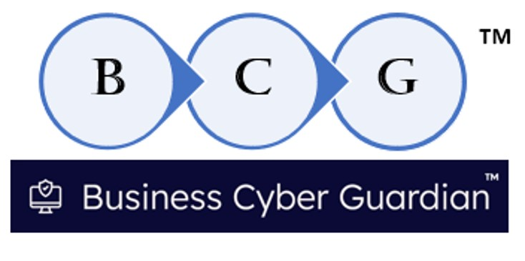
BUSINESS CYBER GUARDIAN™ :
A Software Engineering Company dedicated to software supply chain cyber-risk detection solutions for companies, and Active Member of the CISA ICT_SCRM Task Force Software Assurance Workgroup
Attestation Collection:
A Software Publishers Perspective
Dick Brooks, Lead Software Engineer
dick@businesscyberguardian.com

Slide 2


Agenda
BCG background
CISA’s Secure Software Attestation Form Expectations and RSAA Portal
Guidance and Lessons Learned

Slide 3

BCG Background
Software Engineering Company in Westfield, MA providing ICT_SCRM products and services to illuminate cyber-risks and verify products against the “CISA Common Form” requirements for both producers and consumers of software products
Contributor to CISA Software Acquisition Guide
Information and Communications Technology Supply Chain Risk Management (SCRM) Task Force Member
Critical Manufacturing Sector Coordinating Council (CMSCC) Information Technology Subject Matter Expert Contributor
Adviser to Healthcare Sector Coordinating Council
What does BCG do?

Slide 4

BCG Products and Services
Software Assurance Guardian Point Man (SAG-PM™)
Cyber-risk illumination tool to verify products for NIST Guidance in OMB-M-22-18 and the CISA Buyers Guide recommendations
SEC Cybersecurity Disclosure Regulations (17 CFR 229.106)
FDA Vulnerability Disclosure Reporting for MDM
Executive Order 14028 and OMB M-22-18 compliance
GSA SCRIPTS RFQ BPA “ready”
Software Assurance Guardian Community Trust Registry (SAG-CTR™)
Cloud based verification and cyber-risk reporting service using SAG-PM
CISA Common Form verification services
Enables parties to register trust in software products and share findings with other agencies
Supports Internet Engineering Task Force (IETF) Supply Chain Integrity, Transparency and Trust (SCITT) concept listing trusted products (Cloud Service, running on AWS)

Slide 5

CISA’s Secure Software Attestation Form
Guidance and Lessons Learned
Authority: Governing laws including 44 U.S.C. § 3554, E.O.14028, and OMB Memorandum M-22-18
Conditions for Self-Attestation: Software development date or significant version changes after specified dates
Exclusions from Self-Attestation: Federal agency-developed software, freely obtained/open-source software, and certain third-party components
Submission Instructions: Online form via provided URL or PDF submission with specific naming convention
Form Completion: Requires description of software and producer info; CEO or designee signature necessary
Third-Party Assessment Option: Performed by a certified or approved Third Party Assessor Organization
Preparing the organization to meet CISA Attestation Form expectations
Preparing the Software Development Environment to comply
Preparing the people to comply; emphasize understanding of Secure by Design principles and NIST SSDF subset and other NIST Guidance (vuln mgmt.)
Preparing the development and build process to generate required artifacts
Package and prepare to distribute artifacts, i.e. SBOM, VDR POA&M, attestation form, etc.
Perform a risk assessment, based on what is required – see Buyers Guide for “exam questions” – before submitting attestation form to CISA
There are “on-going” requirements to meet, i.e. vulnerability disclosure reporting and software patches to distribute

Slide 6

CISA Software Assurance Guide (SAG)
Key artifact with description of detailed Secure by Design practices for vendors
A “how-to” manual for Secure by Design
Describes Secure by Design practices to customers
A simple 4 step process for customers to check for Secure by Design products
Download the SAG spreadsheet
Send the SAG spreadsheet to Vendors requesting response
Evaluate vendor provided responses against SAG
Decide which vendors/products are trustworthy

Slide 7


Risk and Trust
Guidance and Lessons Learned
ALWAYS REMEMBER
Risk always exists, but trust must be earned and awarded
RISK TRUST
Preparing the organization to meet CISA Attestation Form expectations
Preparing the Software Development Environment to comply
Preparing the people to comply; emphasize understanding of Secure by Design principles and NIST SSDF subset and other NIST Guidance (vuln mgmt.)
Preparing the development and build process to generate required artifacts
Package and prepare to distribute artifacts, i.e. SBOM, VDR POA&M, attestation form, etc.
Perform a risk assessment, based on what is required – see Buyers Guide for “exam questions” – before submitting attestation form to CISA
There are “on-going” requirements to meet, i.e. vulnerability disclosure reporting and software patches to distribute

Slide 8
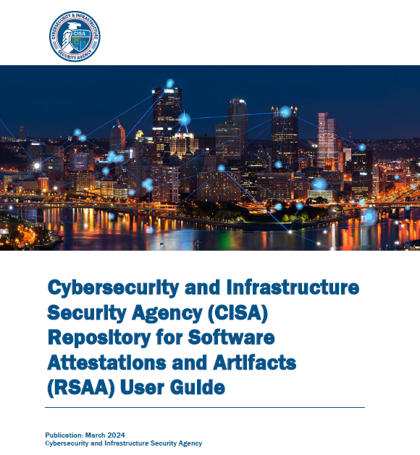
https://www.cisa.gov/resources-tools/resources/repository-software-attestations-and-artifacts-rsaa-user-guide

Slide 9
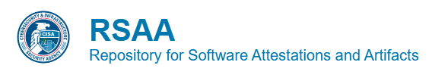
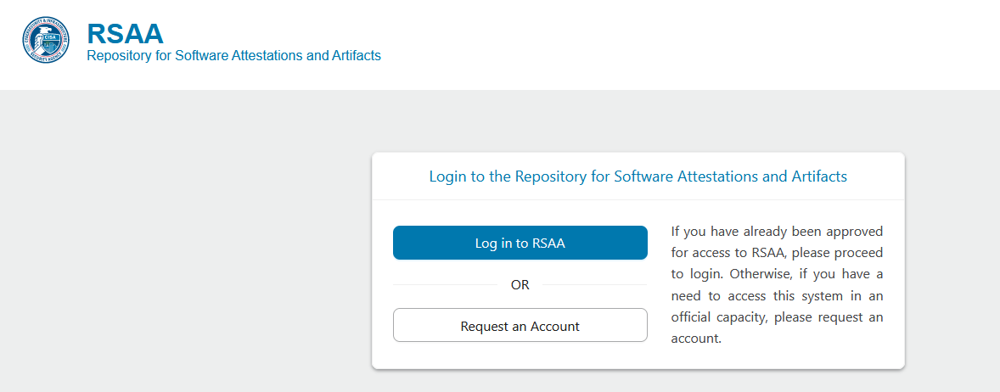
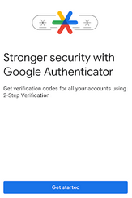
https://softwaresecurity.cisa.gov/login

Slide 10
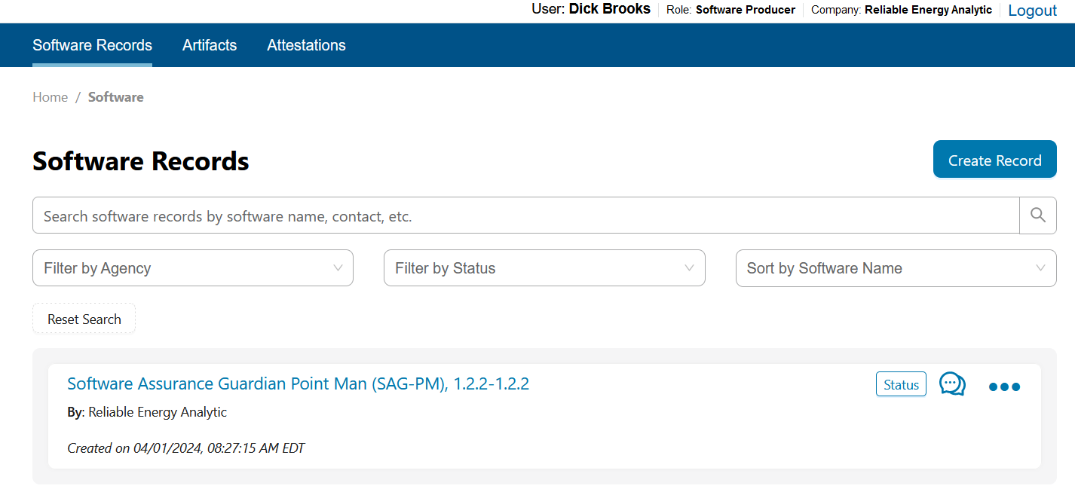
https://softwaresecurity.cisa.gov/login

Slide 11
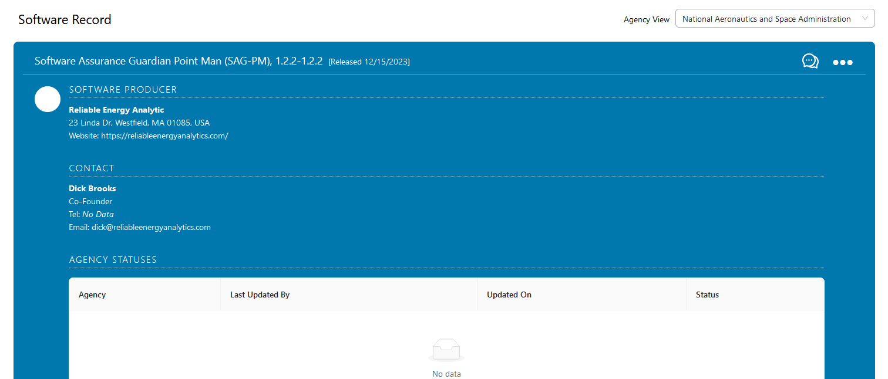

Slide 12
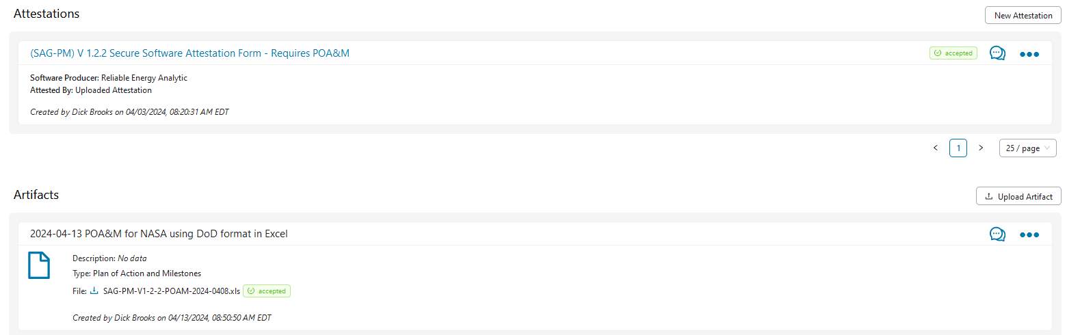

Slide 13
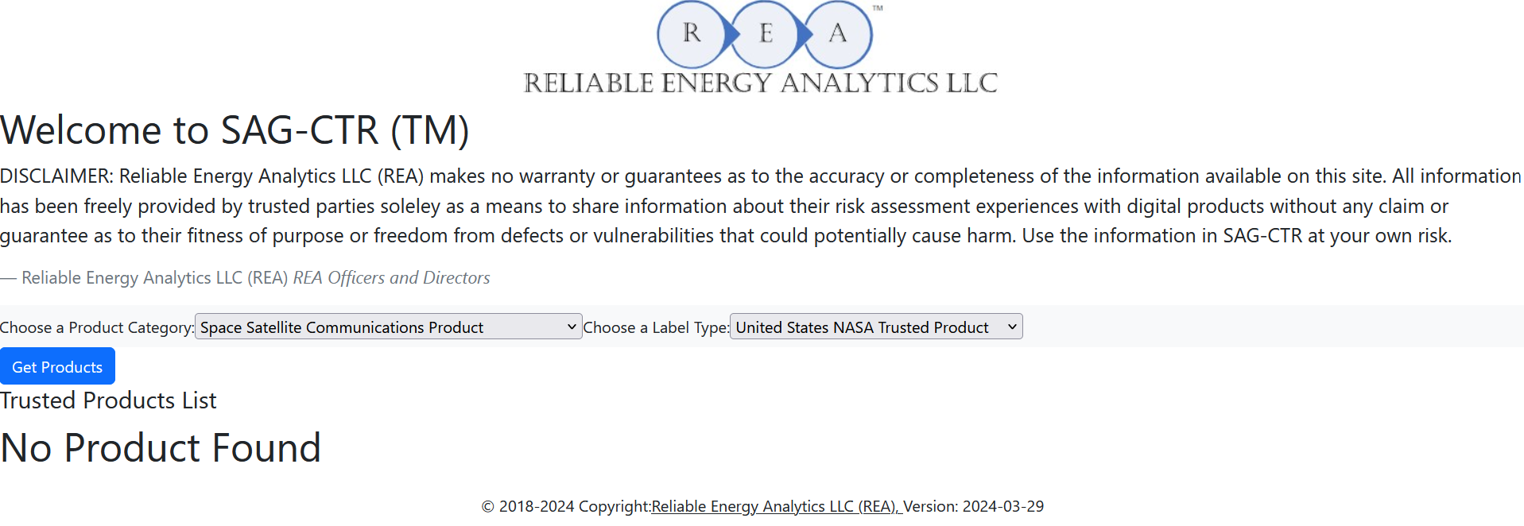
SAG-CTR Demonstration: Sharing Results
SAG-CTR APIs are available for easy integration into other dashboard products and websites, such as app stores:
https://softwareassuranceguardian.com/SAGCTR/
https://softwareassuranceguardian.com/SAGCTR_inquiry/getProductCategories
https://softwareassuranceguardian.com/SAGCTR_inquiry/getLabelTypes
https://softwareassuranceguardian.com/SAGCTR_inquiry/getSAGScore?FileHash=48E0EEB4C538BCD65514D68DDA5E1B41BE9F38AAB3A9B4108F056A27BE1F379A

Slide 14
Lessons Learned
Software Suppliers need to apply for an RSAA account; can take a few days to complete
An authenticator app is needed for MFA (REA uses the Google App)
Only one artifact is required: A Fully Executed CISA Secure Software Attestation Form
Attestation form can represent a single product or an entire product line; REA submitted a “product attestation”
Agencies may also request other artifacts, such as an SBOM and Vulnerability Disclosure Report (VDR) see Buyers Guide for details
Software Suppliers should prepare by organizing all of the artifacts using a Vendor Response Form (VRF document) – not required, but useful for keeping a “RSAA submission package organized”. BCG submitted its VRF package as an artifact in RSAA.
BCG anticipated having to supply all of the required and optional artifacts and prepared by uploading all artifacts to RSAA as a package
Artifact uploads can be slow to process – over a minute to accept/reject

Slide 15
Lessons Learned
Artifacts need to be “Attached” to an Attestation (separate step)
Attestations need to be “Attached” to a software record (separate step)
Attestations need to be “Associated” with an Agency/Department in RSAA
There are some open questions about using RSAA to indicate that an attestation requires a POA&M (will be addressed in Buyers Guide FAQ)
Recommend that Software Suppliers use the Buyers Guide Spreadsheet for the best chance at “passing the attestation test”, based on the Buyers Guide materials.
Consider the benefits of sharing RSAA processing results with other agencies using a “Trust Registry”, like IETF SCITT
It’s in a suppliers best interest to provide information up front, in the RSAA portal, to avoid back-forth on items the “Common Form” doesn’t address, like foreign ownership and influence (FOCI)

Slide 16
Questions?
Thank You
Dick Brooks
dick@businesscyberguardian.com

